Slide 1

Green Building

Slide 2
Presentation done by
Sarrah Bastawala - 201081057
Himanshu Chougule - 201080048
Pratham Shah - 201080056
Meloni Patel - 201081059
Mansi Shingate - 201081031
Dhrumil Raigagla - 201080061
Nishant Patil - 201080051
Bhavik Bharambe - 201080071
Rushil Shivade - 201080053
Vedant Jamthe - 201080038

Slide 3
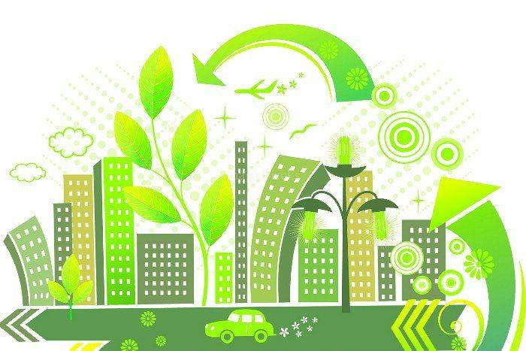
Introduction to Green building
Buildings can have both positive and negative impacts on their surroundings as well as the people who inhabit them every day. Building homes and skyscrapers with thousands of pounds of concrete, steel, and other materials is a major contributor to pollution and energy use.
Our homes and office building’s lighting, heating and cooling, poor insulation, and
integration into this running environment have a lasting impact on energy use and costs.
They require larger amounts of power and water to keep comfortable, which just keeps going on
indefinitely.
Buildings accounted for 28% of energy-related CO2 emissions in 2019.
In order to reduce that problem, we need some innovations around how we build our houses,
offices, and skyscrapers.
This is where green buildings come in.
These constructions are designed and built with the goal of creating positive impacts
on the environment and climate.
They can combine energy efficiency and renewable energy to reduce power consumption, benefit the environment, and improve quality of life for the people that live or work in those buildings.
The concept of green building has been scaling from small houses to big offices and skyscrapers around the globe.
Some international certifications have been developed in order to provide clear guidelines
on how to do it.
The U.S. Green Building Council (USGBC) developed the Leadership in Energy and Environmental Design (known as LEED) to rate green buildings and provide owners with a framework of cost-saving, high-efficiency, and health for design, construction, operations, and maintenance.

Slide 4
Why build green?
So, first off why not. It is not harming anyone in anyway. The purpose of it is to save earth and provide a better living environment for the human beings at the end. So just seize the opportunity and start making a change. Human nature is all about doing things that benefits them so here are the benefits of green building. Conventional buildings have a substantial impact on the health and wellbeing of people and the planet. They use resources, generate waste, and emit greenhouse gases throughout their life cycle which can be 50, 75, or more years. Where as green building makes efficient use of energy, water and other resources. They make use of renewable energy resources such as solar energy. The environmental benefits of green include the protection of ecosystems and biodiversity, improved air and water quality, less waste flowing into streams and the conservation of natural resources. Green buildings can also result in lower operating costs because they typically use less energy and materials and provides improved air quality which improves the health of occupant. Improved health results in improved lifestyle which in turn improves your social life as well. So, green buildings not only provides environmental and economic benefits but social benefits as well.

Slide 5
Advantages of Green Building
Cost
Efficiency:
Water efficiency
Energy efficiency
Resource efficiency
Improve productivity
Enhancing health
Reducing operating costs and maintenance
Carbon footprint reduction

Slide 6
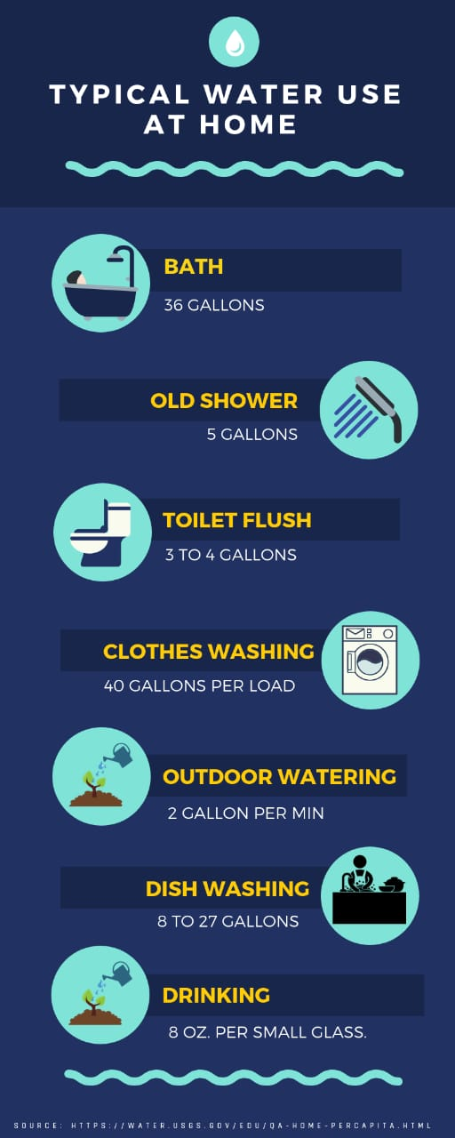
WATER EFFICIENCY
What is Water Efficiency?
How does Green Building encourage Water Efficiency?
Effective strategies :
Install efficient plumbing fixtures.
Use non-potable water.
Install submeters.
Choose locally adapted plants.
Use xeriscaping.
Select efficient irrigation technologies.
Today there are several water conservation strategies which involve a low cost of implementation and have a very quick payback.The three key components of water efficiency in green buildings according to the USGBC (U.S. Green Building Council) are:
Reduce Indoor Potable Water Use
Reducing Water Consumption to Save Energy
Improve Environmental Well-Being

Slide 7
Energy Efficiency
Energy efficiency is the key to achieve sustainability in green building.
Higher levels of energy efficiency reduce carbon transmissions- both from power plants and the home’s own energy systems.
Green building include measures to reduce energy consumptions- both the embodied energy required to extract, process, transport and install building materials and operating energy to provide services such as heating and power for equipment.
The benefits of energy efficiency in green building are as follows:
Energy efficiency in green building is compelling, cost-effective and can help consumers to save money in the long term.
Energy efficiency in green building helps to meet energy targets and resource energy shortage.
Energy efficiency is good for industry and creates new jobs for companies.

Slide 8
Material Efficiency
Material efficiency,entails the pursuit of the technical strategies, business models, consumer preferences and policy instruments that would lead to a substantial reduction in the production of high-volume energy-intensive materials required to deliver human well-being.
The motivations for material efficiency include reducing energy demand, reducing the emissions and other environmental impacts of industry, and increasing national resource security.
There are many technical strategies that might bring it about, and these could mainly be implemented today if preferred by customers or producers.
However mass-production ,economic cost,collective agreement and cooperation between various institutions and government entities remain a massive challenge.

Slide 9
Waste Reduction
Designing for limited waste is the essential first step towards an effective waste management plan. Green architecture also seeks to reduce waste of energy, water and materials used during construction. Well-designed buildings also help reduce the amount of waste generated by the occupants as well, by providing on-site solutions such as compost bins to reduce matter going to landfills. When buildings reach the end of their useful life, they are typically demolished and hauled to landfills. Deconstruction is a method of harvesting what is commonly considered "waste" and reclaiming it into useful building material. Extending the useful life of a structure also reduces waste – building materials that are light and easy to work with make renovations easier. Waste water from sources such as dishwashing or washing machines, can be used for subsurface irrigation, or if treated, for non-potable purposes. This can also reduce impact on wells and water treatment plants.

Slide 10
Operations and maintenance optimization
No matter how sustainable a building may have been in its design and construction, it can only remain so if it is operated responsibly and maintained properly. Ensuring operations and maintenance(O&M) personnel are part of the project's planning and development process will help retain the green criteria designed at the onset of the project.
Every aspect of green building is integrated into the O&M phase of a building's life. The addition of new green technologies also falls on the O&M staff. Although the goal of waste reduction may be applied during the design, construction and demolition phases of a building's life-cycle, it is in the O&M phase that green practices such as recycling and air quality enhancement take place.
O&M staff should aim to establish best practices in energy efficiency, resource conservation, ecologically sensitive products and other sustainable practices. Education of building operators and occupants is key to effective implementation of sustainable strategies in O&M services.

Slide 11
INDOOR ENVIRONMENTAL QUALITY ENHANCEMENT
Indoor environmental quality (IEQ) encompasses the conditions inside a building - air quality,lighting,thermal conditions,ergonomics and their effects on residents.
Strategies for addressing IEQ include those that protect human health,improve quality of life and reduce stress and potential injuries.
Strategies that improve employees’ health and productivity over the long run can have a large return on investment. IEQ goals often on providing stimulating and comfortable environments for occupants and minimizing the risk of building-related health problems.
Effective strategies improving occupants’ comfort and control
Install operable windows.
Give occupants temperature and ventilation control.
Give occupants lighting control.
Conduct occupant surveys.
Provide ergonomic furniture.

Slide 12
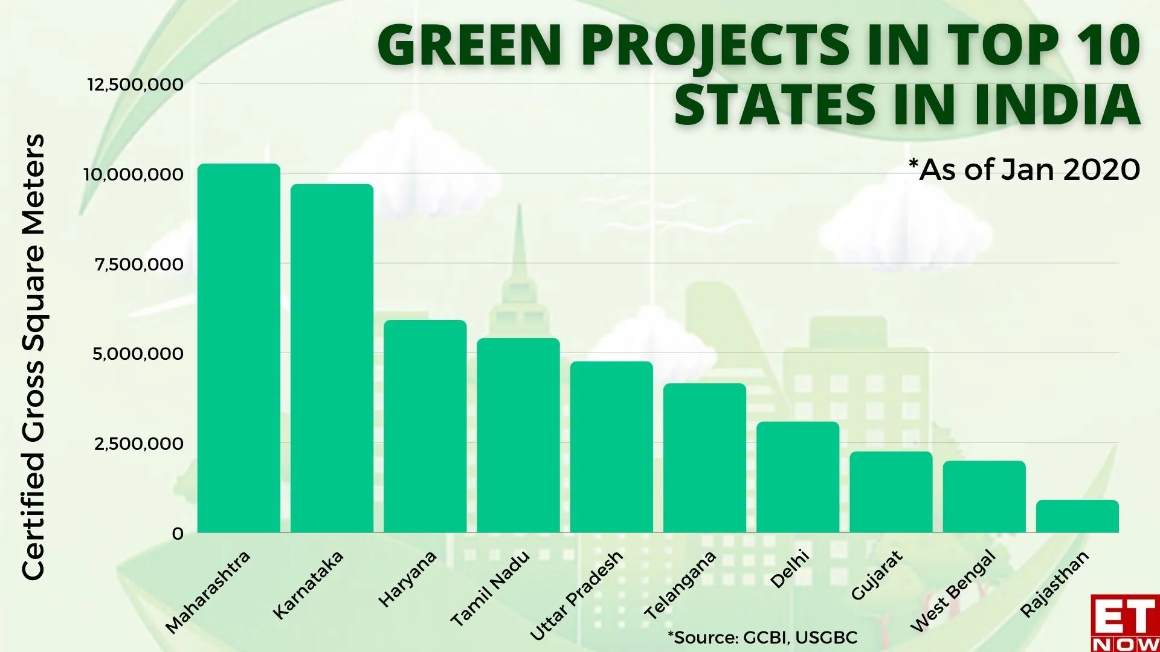

Slide 13
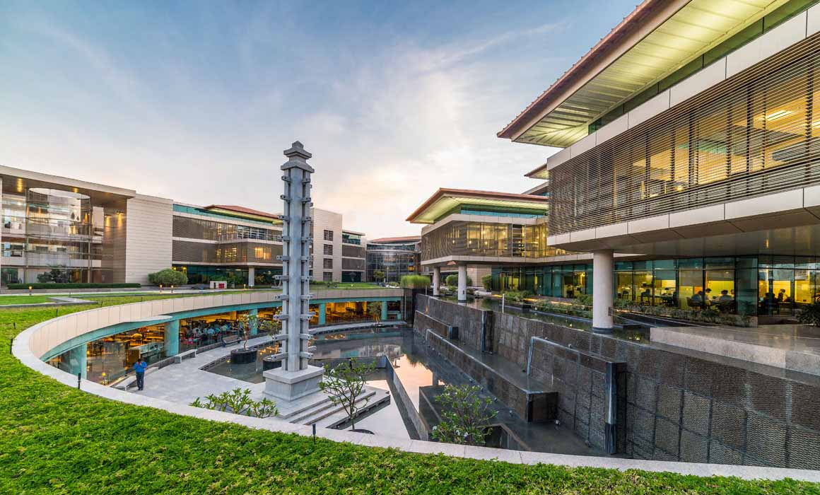
REMARKABLE GREEN BUILDINGS IN INDIA
1. Suzlon One Earth, Pune
Has received LEED Platinum rating in 2010
The concept “Office in the garden”
The campus has 18 hybrid wind turbines that fulfil 7% of the total
energy consumption, the rest of energy demand is met from offsite.
Wind turbines.
Suzlon one earth is 100% powered by onsite and offsite renewable sources.

Slide 14
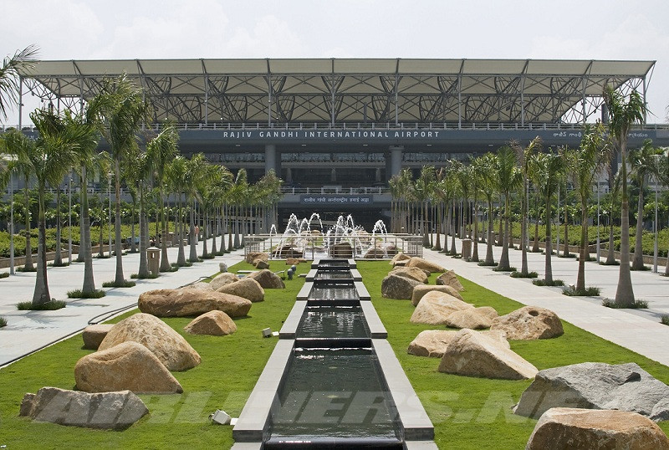
REMARKABLE GREEN BUILDINGS IN INDIA
2. Rajiv Gandhi International Airport (RGIA), Hyderabad
The structure of the airport is designed in a way so as to consume less water, electricity and conserves natural resources.
There is a green belt of 273 hectares with many plants.
RGIA has been successful in saving energy for nearly 3.97 million kWh and have reduced the carbon footprint by 3331 tons.
This airport sets a benchmark for the green buildings in India.

Slide 15
REMARKABLE GREEN BUILDINGS IN INDIA
Infosys Limited, Mysore
Infinity Benchmark, Kolkata
I-Gate Knowledge Centre, Noida
Bank Of India, Goa
Olympia Tech Park Chennai
AND MANY MORE!

Slide 16

THANK YOU!!!

